Slide 1


Noida Institute of Engineering and Technology, Greater Noida
Refinement and Prototyping
Unit:2
Design Thinking II
Ms. Anuradha Singh
Assistant Professor
Department of CSE
Course Details (B Tech V Sem)

Slide 2
Noida Institute of Engineering and Technology, Greater Noida
FACULTY PROFILE
Name of Faculty: Ms. Anuradha Singh
Designation & Department: Assistant Professor, CSE Dept.
Qualification: B.TECH, MTech

Slide 3
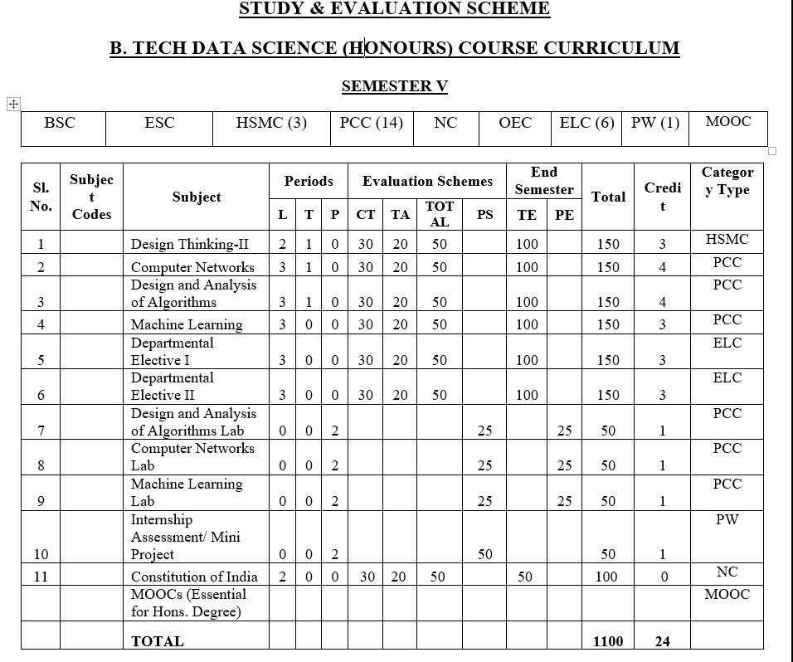
Evaluation Scheme

Slide 4

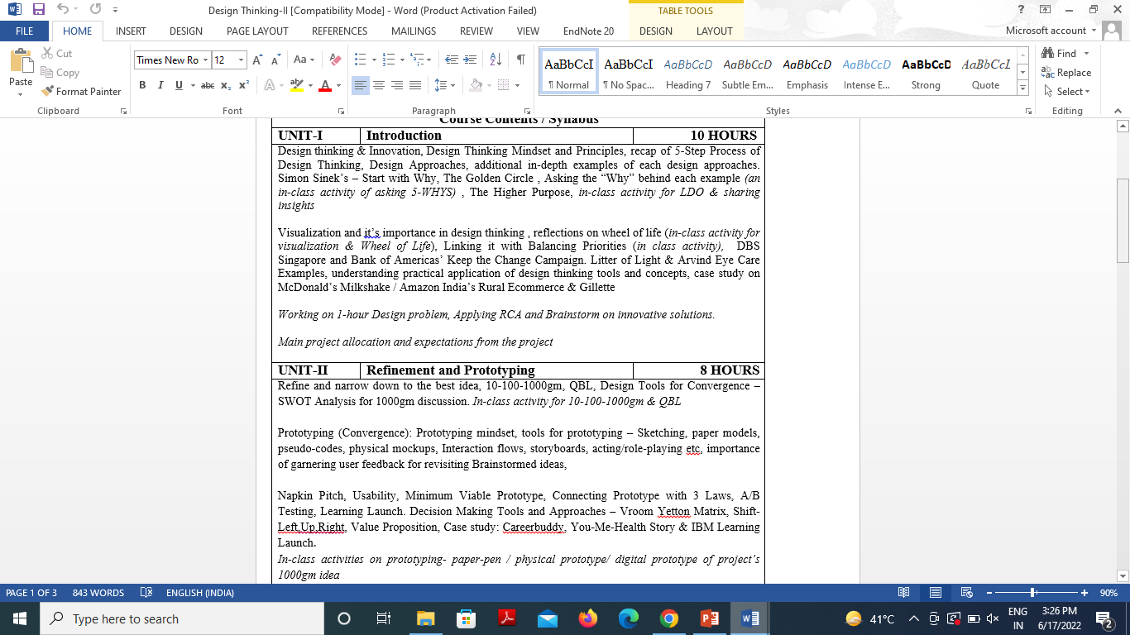
Syllabus

Slide 5

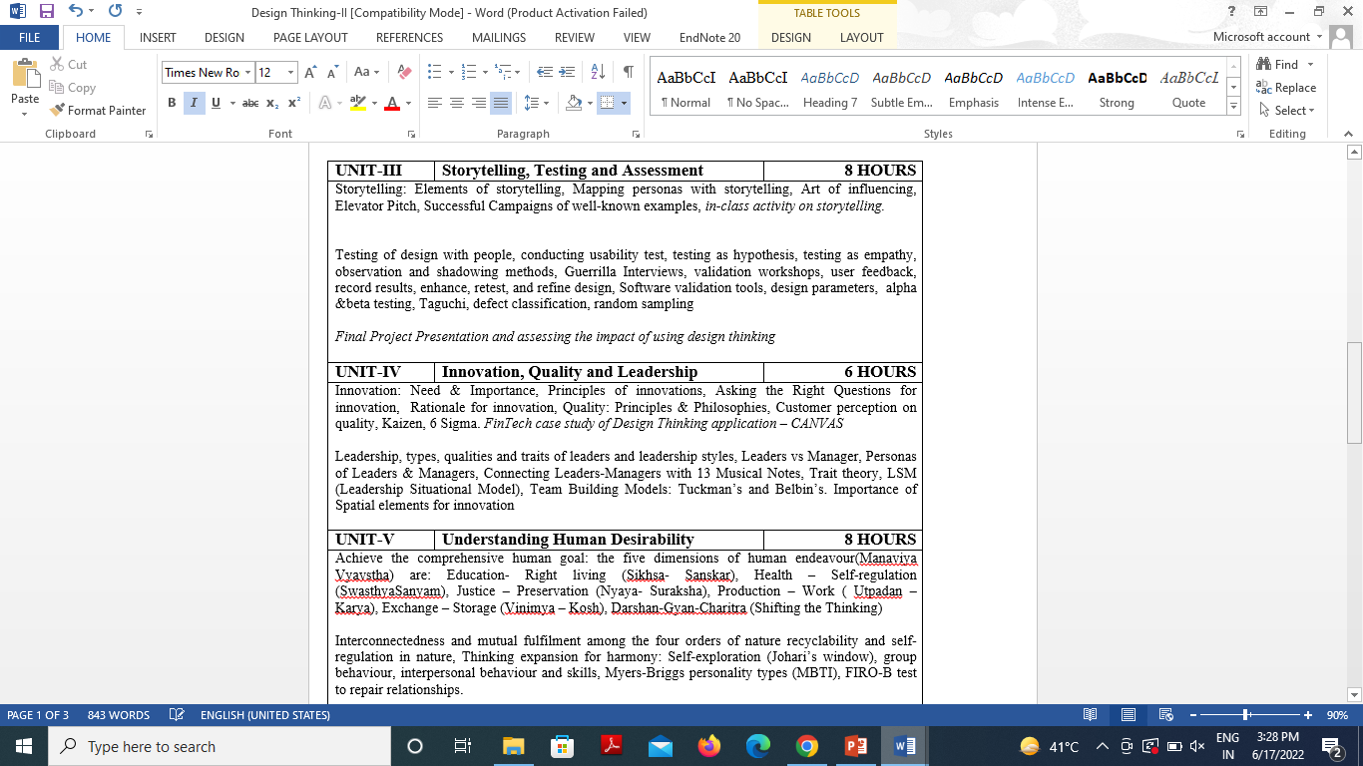
Syllabus

Slide 6

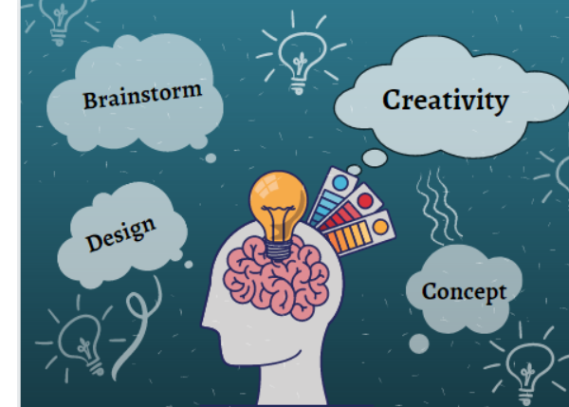
Branch wise Application
Students learn how to have creative confidence in their abilities to adapt and respond to new and difficult challenges.
Students acquiring design thinking skills are able to identify and develop innovative and creative solutions to problems as and when they face them.
Students transform as optimistic, empathetic, and smart working members of the society who can solve complex challenges of the coming future.
Students learn the fundamentals of Problem-solving with Design Thinking.
Students are able to use and integrate design thinking skills learned to solve real-life problems.
Students get to learn the top in-demand skills like problem-solving, decision making, and creative thinking from top industry experts.

Slide 7

Course Objective
The objective of this course is to
Upgrade Design Thinking skills by learning & applying advanced and contextual Design Thinking Tools.
It aims to solve a Real-Life Problem by applying Design Thinking to create an impact for all the stakeholders.

Slide 8
Course Outcome
At the end of the semester, the student will be able:
 | Description | Bloom’s Taxonomy
CO1 | Learn sophisticated design tools to sharpen their problem-solving skills | K2
CO2 | Generate innovate ideas using design thinking tools and converge to feasible idea for breakthrough solution | K3,K4
CO3 | Implement storytelling for persuasive articulation | K3
CO4 | Understanding the nature of leadership empowerment | K2
CO5 | Understand the role of a human being in ensuring harmony in society and nature. | K2

Slide 9

Program Outcome
At the end of the semester, the student will be able:
POs | Engineering Graduates will be able to
PO1 | Engineering Knowledge
PO2 | Problem Analysis
PO3 | Design & Development of solutions
PO4 | Conduct Investigation of complex problems
PO5 | Modern Tool Usage
PO6 | The Engineer and Society
PO7 | Environment and sustainability
PO8 | Ethics
PO9 | Individual & Team work
PO10 | Communication
PO11 | Project management and Finance
PO12 | Life Long Learning

Slide 10
Program Specific Outcomes
S.NO. | Program Specific Outcomes | PSO Description
1 | PSO1 | The ability to identify, analyze real world problems and design their ethical solutions using artificial intelligence, robotics, virtual/augmented reality, data analytics, block chain technology, and cloud computing.
2 | PSO2 | The ability to design and develop the hardware sensor devices and related interfacing software systems for solving complex engineering problems.
3 | PSO3 | The ability to understand inter-disciplinary computing techniques and to apply them in the design of advanced computing.
4 | PSO4 | The ability to conduct investigation of complex problems with the help of technical, managerial, leadership qualities, and modern engineering tools provided by industry-sponsored laboratories.

Slide 11
CO-PO Mapping
Design Thinking
CO.K | PO1 | PO2 | PO3 | PO4 | PO5 | PO6 | PO7 | PO8 | PO9 | PO10 | PO11 | PO12
ACSE0503.1 | 3 | 3 | 3 | 3 | 2 | - | - | - | 2 | 2 | - | 3
ACSE0503.2 | 3 | 3 | 3 | 3 | 2 | 2 | - | 1 | 1 | 1 | - | 3
ACSE0503.3 | 3 | 3 | 2 | 3 | 3 | 2 | - | 2 | 1 | 1 | 2 | 3
ACSE0503.4 | 3 | 3 | 3 | 3 | 2 | 2 | - | 2 | 2 | 1 | 3 | 3
ACSE0503.5 | 2 | 2 | 2 | 2 | 2 | 2 | - | 2 | 1 | 1 | 1 | 2
Average | 2.8 | 2.8 | 2.6 | 2.8 | 2.2 | 1.6 | - | 1.8 | 1.4 | 1.2 | 1.2 | 2.8

Slide 12
CO-PSO Mapping
 | PSO1 | PSO2 | PSO3 | PSO4
ACSE0503.1 | 3 | 2 | 2 | -
ACSE0503.2 | 3 | 3 | 2 | -
ACSE0503.3 | 3 | 3 | 3 | -
ACSE0503.4 | 3 | 3 | 2 | -
ACSE0503.5 | 3 | 3 | 2 | -
Average | 3 | 2.8 | 2.2 | -

Slide 13
Program Educational Objectives (PEOs)
Program Educational Objectives (PEOs) | PEOs Description
PEOs | To have an excellent scientific and engineering breadth to comprehend, analyze, design and provide sustainable solutions for real-life problems using state-of-the-art technologies.
PEOs | To have a successful career in industries, to pursue higher studies or to support entrepreneurial endeavors and to face global challenges.
PEOs | To have an effective communication skill, professional attitude, ethical values and a desire to learn specific knowledge in emerging trends, technologies for research, innovation and product development and contribution to society.
PEOs | To have life-long learning for up-skilling and re-skilling for successful professional career as engineer, scientist, entrepreneur, and bureaucrat for betterment of society.

Slide 14
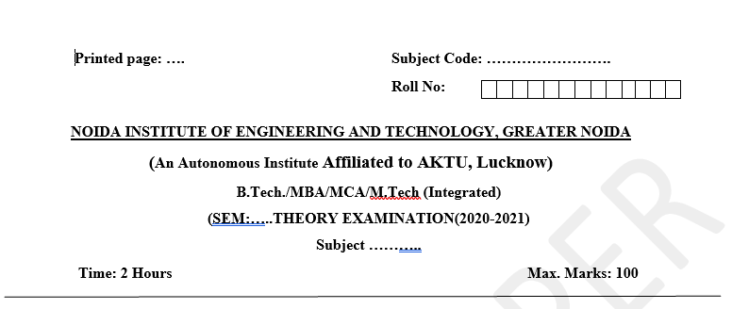
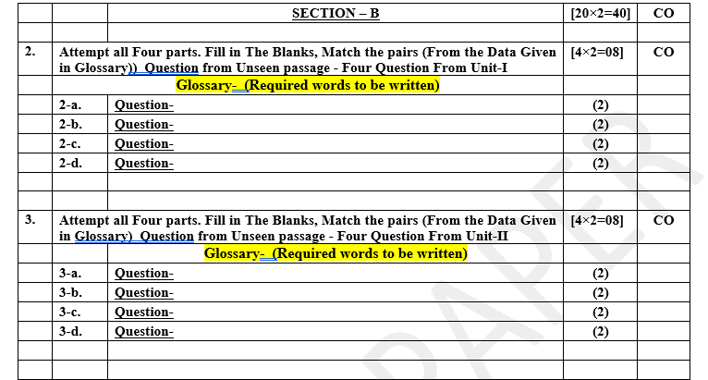
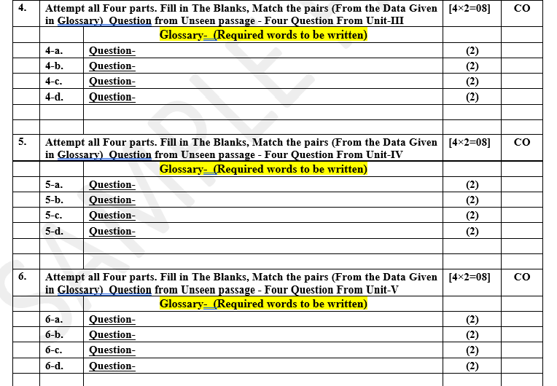
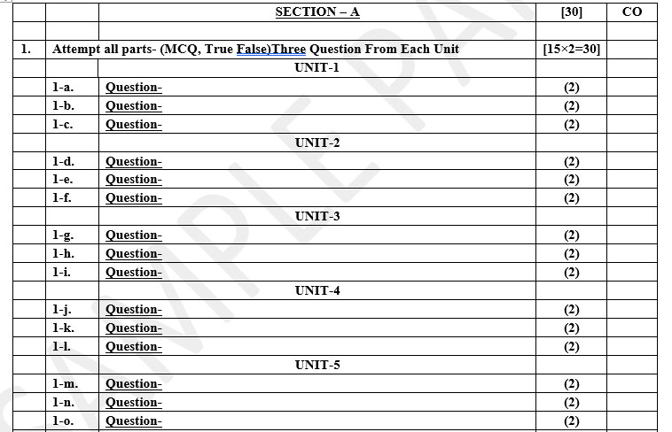
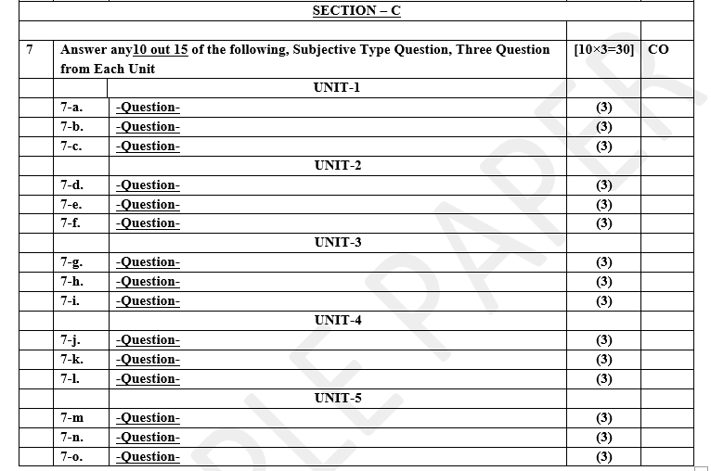
Pattern of Online External Exam Question Paper (100 marks)

Slide 15
Prerequisite and Recap
Pre-requisites: Student must complete Design Thinking-I course

Slide 16
Brief Introduction about the subject with videos
Design Thinking is not an exclusive property of designers — all great innovators in literature, art, music, science, engineering, and business have practiced it. So, why call it Design Thinking? What’s special about Design Thinking is that designers’ work processes can help us systematically extract, teach, learn and apply these human-centered techniques to solve problems in a creative and innovative way — in our designs, in our businesses, in our countries, in our lives.​
https://careerfoundry.com/en/blog/ux-design/what-is-design-thinking-everything-you-need-to-know-to-get-started/
https://www.youtube.com/watch?v=-ySx-S5FcCI ​

Slide 17
Unit Content
Refine and narrow down to the best idea, 10-100-1000gm, QBL, Design Tools for Convergence – SWOT Analysis for 1000gm discussion. In-class activity for 10-100-1000gm & QBL
Prototyping (Convergence): Prototyping mindset, tools for prototyping – Sketching, paper models, pseudo-codes, physical mockups, Interaction flows, storyboards, acting/role-playing etc, importance of garnering user feedback for revisiting Brainstormed ideas,
Napkin Pitch, Usability, Minimum Viable Prototype, Connecting Prototype with 3 Laws, A/B Testing, Learning Launch. Decision Making Tools and Approaches – Vroom Yetton Matrix, Shift-Left,Up,Right, Value Proposition, Case study: Careerbuddy, You-Me-Health Story & IBM Learning Launch.
In-class activities on prototyping- paper-pen / physical prototype/ digital prototype of project’s 1000gm idea

Slide 18
Unit Objective
.
To get detailed insights about the methods used in prototype development

Slide 19
Topic Objective
Refine and narrow down to the best idea, 10-100-1000gm, QBL, Design Tools for Convergence – SWOT Analysis for 1000gm discussion. In-class activity for 10-100-1000gm & QBL | To learn different types of design tools
Prototyping (Convergence): Prototyping mindset, tools for prototyping – Sketching, paper models, pseudo-codes, physical mockups, Interaction flows, storyboards, acting/role-playing etc, importance of garnering user feedback for revisiting Brainstormed ideas, | To learn different types of tools used in prototyping and ideation
Napkin Pitch, Usability, Minimum Viable Prototype, Connecting Prototype with 3 Laws, A/B Testing, Learning Launch. Decision Making Tools and Approaches – Vroom Yetton Matrix, Shift-Left,Up,Right, Value Proposition, Case study: Careerbuddy, You-Me-Health Story & IBM Learning Launch | To understand decision making tools and approaches

Slide 20
Refine and narrow down to the best idea(CO2)
In the Ideation stage, design thinkers spark off ideas — in the form of questions and solutions — through creative and curious activities such as Brainstorms and Worst Possible Idea.
When facilitated in a successful way, Ideation is an exciting process. The goal is to generate a large number of ideas — ideas that potentially inspire newer, better ideas — that the team can then cut down into the best, most practical and innovative ones.
“Ideation is the mode of the design process in which you concentrate on idea generation. Mentally it represents a process of “going wide” in terms of concepts and outcomes. Ideation provides both the fuel and also the source material for building prototypes and getting innovative solutions into the hands of your users.”

Slide 21
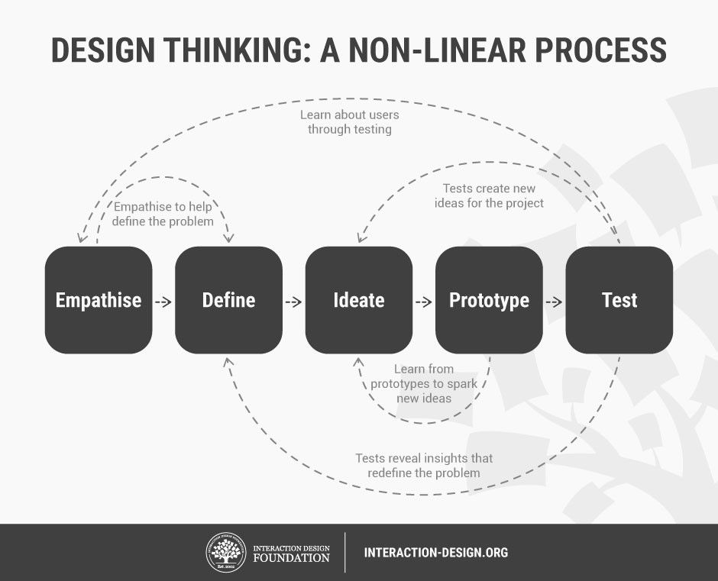
Design Thinking: Stages

Slide 22
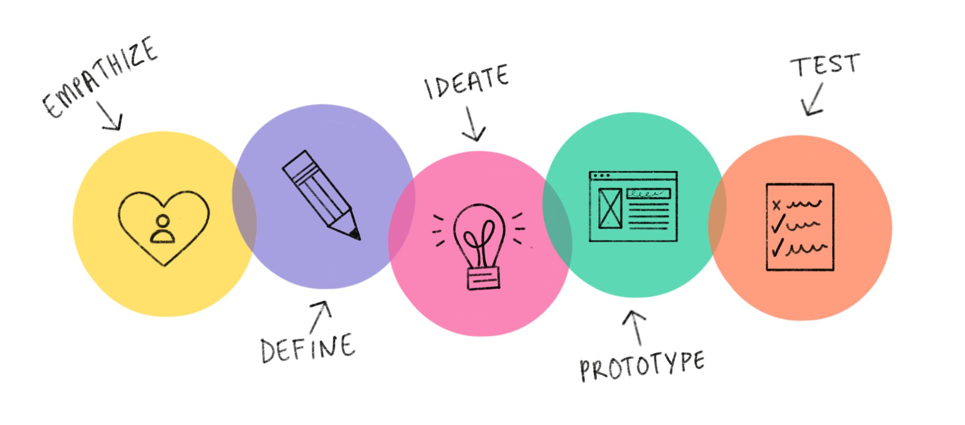
Design Thinking: Stages

Slide 23
Ideation
Ideation Will Help You:
Ask the right questions and innovate.
Step beyond the obvious solutions and therefore increase the innovation potential of your solution.
Bring together perspectives and strengths of team members.
Uncover unexpected areas of innovation.
Create volume and variety in your innovation options.
Get obvious solutions out of your heads, and drive your team beyond them.

Slide 24
Ideation Methods to Spark Innovative Ideas
There are hundreds of ideation methods. Some methods are merely renamed or slightly adapted versions of more foundational techniques. Here you’ll get brief overview of some of the best methods:
Brainstorm
Braindump
Brainwrite
Brainwalk
Mindmap
Sketch or Sketchstorm
Analogies
Provocation
Movement
Bodystorm

Slide 25
Sketch / Sketchstorm
In design thinking, Sketch refers to the process of quickly drawing or sketching out ideas, solutions, or concepts. It allows teams to visualize thoughts and generate a rough representation of potential solutions to problems.
Sketchstorm is a more intense version of sketching where multiple ideas are rapidly sketched in quick succession. This technique is used to push creativity and encourage the generation of as many ideas as possible.

Slide 26
Example of Sketch / Sketchstorm
Sketch: One team member draws a rough sketch of a water bottle with a sleek design, a built-in handle for easy carrying, and a detachable filter for purifying water.The sketch might show:A cylindrical shape.A handle on the side for portability.A filter near the top.The sketch is simple, focusing on the core idea of the design.
Sketchstorm: In a sketchstorm session, the team quickly generates many different sketches of water bottles in a short period.One sketch might show a collapsible water bottle that folds to fit into a bag.Another could have a compartment to store small snacks or vitamins.A third sketch might emphasize a bottle with a built-in straw and temperature control.One more might focus on sustainable materials like bamboo or recycled plastic.

Slide 27
Analogies
In design thinking, analogies are comparisons used to generate innovative solutions by drawing parallels between the problem at hand and situations from unrelated fields. By finding similar challenges or processes in other domains, designers can transfer insights and ideas to solve their own problems more creatively.
Problem: Designing a faster and more efficient checkout process at a grocery store.
Analogy:
Compare the grocery checkout process to a car race pit stop. In a pit stop, every task (fueling, tire change, etc.) happens quickly and simultaneously, with the team working together efficiently.

Slide 28
Provocation
Provocation is a creative technique used to break out of conventional thinking patterns and stimulate fresh ideas. It involves making deliberately unusual, bold, or seemingly illogical statements to provoke new perspectives and ideas. The goal is to challenge assumptions and encourage brainstorming that goes beyond obvious solutions.

Slide 29
Activity
Scenario:
You are working on improving the classroom learning experience for students.
Provocative Statement:
"What if there were no teachers in the classroom?"
Exploring the Possibilities:
At first, this might seem impossible or counterproductive, but it forces you to think differently:
Could students learn by themselves using AI or technology?
Can peer learning be more effective, where students teach each other?
What if learning was more project-based and collaborative, with minimal teacher involvement?
Refining the Idea:
While having no teachers isn’t feasible, this provocation could lead to innovative ideas like:
Introducing more self-paced, personalized learning platforms.
Creating peer-led discussion groups or project teams.
Using AI tutors or virtual assistants for certain topics, reducing the teacher's workload.

Slide 30
Movement
In design thinking, movement refers to the progression and flow of ideas during the creative problem-solving process. It's about constantly moving forward, iterating, and evolving solutions instead of getting stuck on a single idea or phase. The concept of movement emphasizes flexibility, agility, and the willingness to adapt and refine ideas as more insights are gained.

Slide 31
EXAMPLE
Example of Movement:
When designing a new shopping app, you might:
Start by empathizing with users and understanding their pain points.
Define the problem and gather user insights to guide your design.
Ideate multiple possible features, like voice search or one-click checkout.
Prototype a few of those features to test with users.
Test the prototype and learn that users prefer a simpler interface, which leads you back to refining the prototype.

Slide 32
Bodystorming
Bodystorming is a technique used in design thinking where participants physically act out or simulate scenarios to generate new ideas or solve problems. Unlike traditional brainstorming, where ideas are discussed verbally, bodystorming involves using the body and environment to immerse oneself in the user's experience. This helps teams understand problems more deeply and uncover insights that might not arise through conversation alone.

Slide 33
Active Facilitation
It is not always easy to facilitate a truly fruitful ideation session, which may be the reason why many of us have had negative experiences in the past.
However, Ideation sessions can indeed be fun and exciting, but they demand a lot of preparation and team member concentration in order to be fruitful. To sit the team down with a blank piece of paper and ask them to come up with ideas will likely result in failure. Likewise, to have everyone shout out their own ideas is likely to result in failure.
People need guidance, inspiration and activities, in a physical and cognitive manner, in order to get the process started. Ideation is a creative and concentrated process; those involved should be provided with an environment that facilitates free, open, and the non-judgmental sharing of ideas.

Slide 34
Active Facilitation
In Ideation sessions, it’s important to create the right type of environment to help create a creative work culture with a curious, courageous, and concentrated atmosphere.
Instead of using a boardroom with the CEO sitting at the head of the table, Design Thinking and Ideation sessions require a space in which everyone is equal.
The Ideation room must have sufficient space for people to feel comfortable, but the atmosphere shouldn't be sterile, and team members shouldn't have to shout in order to be heard.
You should also designate someone to take down contributors' ideas and draw/write them on the whiteboard/wall/poster.
If the process begins to slow down and people seem to be running into a dead-end, the facilitator should impose constraints, such as: "what if there was no top- level navigation bar?" or "How-might-we go about the task if we were 8 years old?"
Alternatively, you might want to set targets, such as filling a brainstorming sheet within ten minutes.
https://youtu.be/jI4uMVS9A9o?si=eTtDQtIWvxg-u5Pw

Slide 35
Case Study : Improving Cafeteria Experience
Steps for the Ideation Session:
1. Define the Problem (5 minutes):
Problem: "How can we make the school cafeteria more enjoyable for students?"
Make sure everyone understands the problem before moving forward.
2. Brainstorm Ideas (15 minutes):
Encourage everyone to share as many ideas as possible, no matter how simple or wild.
Example ideas:
Offer healthier meal options.
Create themed meal days (e.g., pizza day, taco Tuesday).
Introduce a pre-order app for quicker service.
Add more comfortable seating.
Play music during lunch.
3. Organize and Discuss Ideas (10 minutes):
Group similar ideas together.
Discuss which ideas seem the most interesting, fun, or easy to implement.
4. Vote on the Best Ideas (5 minutes):
Have everyone vote for their top 2 or 3 favorite ideas.
Example: The group votes for a pre-order app and themed meal days.
5. Refine and Prioritize (5 minutes):
Discuss how these top ideas can be implemented and what steps to take next.

Slide 36

Brainstorming Rules

Slide 37
Brainstorming Rules
Brainstorming is one of the primary methods employed during the Ideation stage of a typical Design Thinking process.
Brainstorming is a great way to generate many ideas by leveraging the collective thinking of the group, engaging with each other, listening, and building on other ideas.
This method involves focusing on one problem or challenge at a time, while team members build on each other’s responses and ideas with the aim of generating as many potential solutions as possible.
These can then be refined and narrowed down to the best solution(s). Participants must then select the best, the most practical, or the most innovative ideas from the options they’ve come up with.

Slide 38
Brainstorming Rules
Set a time limit
Start with a problem statement, point of view, possible questions, a plan, or a goal and stay focused on the topic
Stay on Topic
Defer judgement or criticism, including non-verbal
Encourage weird, wacky and wild ideas
Aim for quantity
Build on each others' ideas
Be visual
One conversation at a time

Slide 39
10-100-1000gm
Design Thinking is a vast topic and many experts views are available from academia to practitioners. At Intellect, we believe in ‘Design the Thinking’ before ‘Thinking the Design’.
Three Design Thinking principals:
Last 2% is 200%
Prioritize 10 gm / 100 gm / 1000 gm items
Less is More

Slide 40
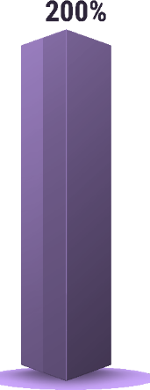
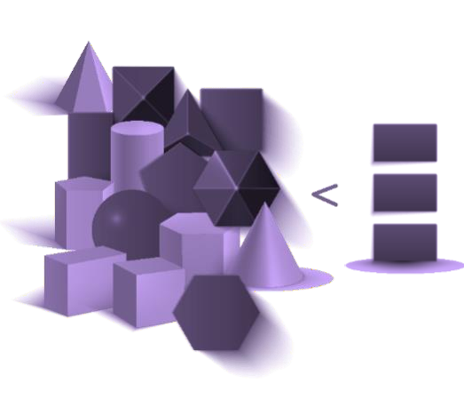
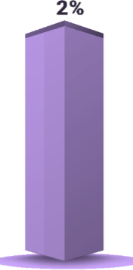



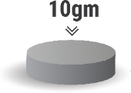

Three Laws of Design Thinking

Slide 41
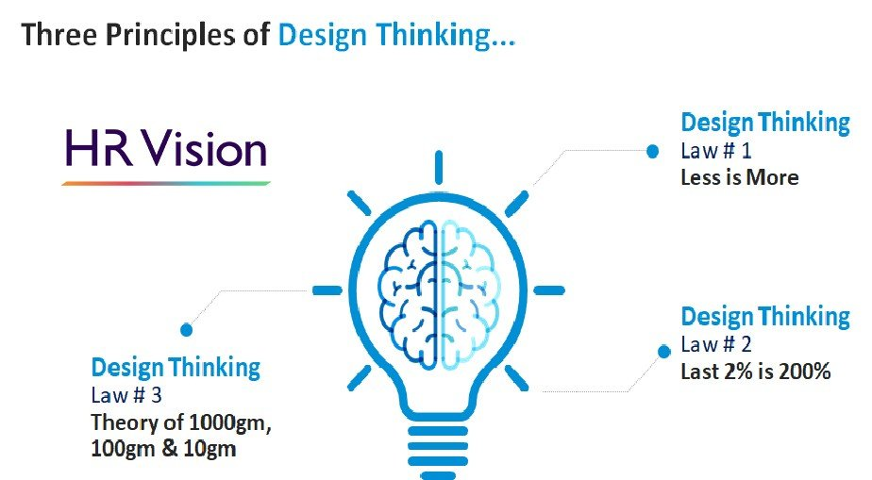
Design Thinking principals

Slide 42
Design Thinking principals
The most relevant principals that can create a difference in their way of working and create a competitive advantage for our customers when they choose Intellect products.
Last 2% is 200% – This is all about understanding that most software products are at similar levels. The difference comes in putting in the last 2% with attention to detail at every aspect of design, engineering and delivery of software products.
Prioritize 10 / 100 / 1000 grams – We all can get incredibly busy and have competing priorities. A successful manager must learn to prioritize. We make it easy by insisting to prioritize items based on the impact that is what we refer to as 1000 grams, 100 grams and 10 grams items.
Less is More – It is very important to remain focused. In software products and engineering, we can easily get distracted to add more functionality and more features, getting into the trap of expanding scope, time and cost. While designing software, and almost in everything else we do at work, we need to remain focused and try to resist an attempt to overload features and functionalities instead we need to design keeping in mind the principle of “Less is More“.
To summarize in one line, we create higher value in last 2% completion, prioritize 1000 gram items and deliver on time with ‘Less is More’.

Slide 43
Convergent Thinking
Convergent thinking is an ideation mode which designers use to analyze, filter, evaluate, clarify and modify ideas they have generated in divergent thinking.
They use analytical, vertical and linear thinking to find novel and useful ideas, understand the design space possibilities and get closer to potential solutions.
“The best way to have good ideas is to have lots of ideas and throw away the bad ones.”

Slide 44
Convergent Thinking – the Other Side of the Ideation “Coin”
After design teams generate as many ideas as possible in the divergent thinking part of ideation sessions, convergent thinking helps them systematically see whether their ideas might work as real-world solutions. The structure is to:
Sift (examine) through ideas.
Group them into themes.
Find common threads.
Decide on winners and losers.

Slide 45
Convergent Thinking – the Other Side of the Ideation “Coin”
( Cont.)
Convergent thinking helps tighten your focus when evaluating each idea.
For example, convergent thinking process to the idea of a smart water bottle—one that tracks hydration levels, reminds users to drink water, and monitors the water’s temperature. You’d then examine it through three lenses:
Desirability – Would users want this product?” Many users, particularly fitness enthusiasts, health-conscious individuals, and those with busy schedules, might find it useful. However, some users might view it as unnecessary or intrusive.
Concerns like battery life, over-complication for a simple task, or frequent notifications might deter some users.

Slide 46
Convergent Thinking – the Other Side of the Ideation “Coin”
( Cont.)
Viability – “Could a company mass-produce and support it?” (Or would it be unsustainable/too expensive?)
Producing a smart water bottle with sensors, Bluetooth connectivity, and an accompanying app seems feasible for a company with experience in electronics or fitness gadgets.
But the product cost might increase due to the technology involved (sensors, battery, materials), and the question is whether customers would be willing to pay a premium for it.
Additional considerations include software support, such as maintaining an app, which could require frequent updates and bug fixes.

Slide 47
Convergent Thinking – the Other Side of the Ideation “Coin”
( Cont.)
Feasibility – “Is it doable?”
The technology for this product already exists—Bluetooth sensors, hydration tracking apps, and temperature-monitoring devices are well-established. However, combining these features in a way that makes the product durable (e.g., waterproof, long battery life) and easy to use is important. There may be technical challenges in creating a water bottle that’s lightweight yet incorporates all the features, with additional considerations like ensuring the electronics don’t compromise the safety or durability of the bottle.
After using convergent thinking, you might conclude that while the idea of a smart water bottle is desirable to a specific market segment and feasible with current technology, the viability of large-scale production could hinge on balancing costs and consumer price sensitivity.

Slide 48
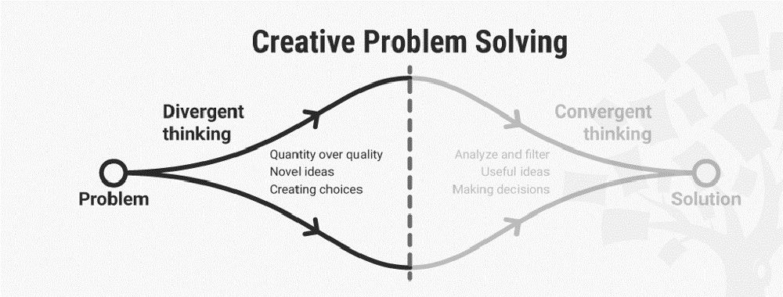
Convergent Thinking

Slide 49
SWOT Analysis
SWOT stands for Strengths, Weaknesses, Opportunities, and Threats, and so a SWOT analysis is a technique for assessing these four aspects of your business.
SWOT Analysis is a tool that can help you to analyze what your company does best now, and to devise a successful strategy for the future. SWOT can also uncover areas of the business that are holding you back, or that your competitors could exploit if you don't protect yourself.
A SWOT analysis examines both internal and external factors – that is, what's going on inside and outside your organization. So some of these factors will be within your control and some will not.

Slide 50
Why Is SWOT Analysis Important?
SWOT Analysis can help you to challenge risky assumptions and to uncover dangerous blindspots about your organization's performance. If you use it carefully and collaboratively, it can deliver new insights on where your business currently is, and help you to develop exactly the right strategy for any situation.
For example, you may be well aware of some of your organization's strengths, but until you record them alongside weaknesses and threats you might not realize how unreliable those strengths actually are.
Equally, you likely have reasonable concerns about some of your business weaknesses but, by going through the analysis systematically, you could find an opportunity, previously overlooked, that could more than compensate.

Slide 51
How to Write a SWOT Analysis
SWOT analysis involves making lists – but so much more, too! When you begin to write one list (say, Strengths), the thought process and research that you'll go through will prompt ideas for the other lists (Weaknesses, Opportunities or Threats). And if you compare these lists side by side, you will likely notice connections and contradictions, which you'll want to highlight and explore.
SWOT Analysis matrix:
Strengths What do you do well? What unique resources can you draw on? What do others see as your strengths? | Weaknesses What could you improve? Where do you have fewer resources than others? What are others likely to see as weaknesses?

Slide 52
How to Write a SWOT Analysis
Opportunities What opportunities are open to you? What trends could you take advantage of? How can you turn your strengths into opportunities? | Threats What threats could harm you? What is your competition doing? What threats do your weaknesses expose to you?
How to Do a SWOT Analysis
Avoid relying on your own, partial understanding of your organization. Your assumptions could be wrong. Instead, gather a team of people from a range of functions and levels to build a broad and insightful list of observations.
Then, every time you identify a Strength, Weakness, Opportunity, or Threat, write it down in the relevant part of the SWOT analysis grid for all to see.

Slide 53

How to Write a SWOT Analysis
Strengths
Strengths are things that your organization does particularly well, or in a way that distinguishes you from your competitors. Think about the advantages your organization has over other organizations. These might be the motivation of your staff, access to certain materials, or a strong set of manufacturing processes.
Your strengths are an integral part of your organization, so think about what makes it "tick." What do you do better than anyone else? What values drive your business?
What unique or lowest-cost resources can you draw upon that others can't? Identify and analyze your organization's Unique Selling Proposition (USP), and add this to the Strengths section.

Slide 54
How to Write a SWOT Analysis
Weaknesses
Weaknesses, like strengths, are inherent features of your organization, so focus on your people, resources, systems, and procedures. Think about what you could improve, and the sorts of practices you should avoid.
Once again, imagine (or find out) how other people in your market see you. Do they notice weaknesses that you tend to be blind to? Take time to examine how and why your competitors are doing better than you. What are you lacking?

Slide 55
How to Write a SWOT Analysis
Opportunities
Opportunities are openings or chances for something positive to happen, but you'll need to claim them for yourself!
They usually arise from situations outside your organization, and require an eye to what might happen in the future. They might arise as developments in the market you serve, or in the technology you use. Being able to spot and exploit opportunities can make a huge difference to your organization's ability to compete and take the lead in your market.
Think about good opportunities that you can exploit immediately. These don't need to be game-changers: even small advantages can increase your organization's competitiveness. What interesting market trends are you aware of, large or small, which could have an impact?
You should also watch out for changes in government policy related to your field. And changes in social patterns, population profiles, and lifestyles can all throw up interesting opportunities.

Slide 56

How to Write a SWOT Analysis
Threats
Threats include anything that can negatively affect your business from the outside, such as supply-chain problems, shifts in market requirements, or a shortage of recruits. It's vital to anticipate threats and to take action against them before you become a victim of them and your growth stalls.
Think about the obstacles you face in getting your product to market and selling. You may notice that quality standards or specifications for your products are changing, and that you'll need to change those products if you're to stay in the lead. Evolving technology is an ever-present threat, as well as an opportunity!
Always consider what your competitors are doing, and whether you should be changing your organization's emphasis to meet the challenge. But remember that what they're doing might not be the right thing for you to do. So, avoid copying them without knowing how it will improve your position.
Be sure to explore whether your organization is especially exposed to external challenges. Do you have bad debt or cash-flow problems, for example, that could make you vulnerable to even small changes in your market? This is the kind of threat that can seriously damage your business, so be alert.

Slide 57

A SWOT Analysis Example
Imagine this scenario: a small start-up consultancy wants a clear picture of its current situation, to decide on a future strategy for growth. The team gathers, and draws up the SWOT Analysis:
Strengths What do you do well? What unique resources can you draw on? What do others see as your strengths? | Weaknesses What could you improve? Where do you have fewer resources than others? What are others likely to see as weaknesses?
We are able to respond very quickly as we have no red tape, and no need for higher management approval. We are able to give really good customer care, as the current small amount of work means we have plenty of time to devote to customers. Our lead consultant has a strong reputation in the market. We can change direction quickly if we find that our marketing is not working. We have low overheads, so we can offer good value to customers. | Our company has little market presence or reputation. We have a small staff, with a shallow skills base in many areas. We are vulnerable to vital staff being sick or leaving. Our cash flow will be unreliable in the early stages.

Slide 58
A SWOT Analysis Example
Opportunities What opportunities are open to you? What trends could you take advantage of? How can you turn your strengths into opportunities? | Threats What threats could harm you? What is your competition doing? What threats do your weaknesses expose to you?
Our business sector is expanding, with many future opportunities for success. Local government wants to encourage local businesses. Our competitors may be slow to adopt new technologies. | Developments in technology may change this market beyond our ability to adapt. A small change in the focus of a large competitor might wipe out any market position we achieve.

Slide 59
When to prototype ?
Imagine this situation:
It’s an exciting new project, something your team had spent months brainstorming and planning, then building and crafting to perfection.
You did all you could to ensure it was just right, with all the necessary features. You tried to ensure that you gave design more focus and that your message was crafted well.
The website attracted attention and brought in many interested visitors looking for the products you'd collected on the site, but somehow the product and service providers just weren't interested in testing it out.
They seemed comfortable just to keep doing business as usual, uninterested in the thousands of hits your website was getting from potential customers.
It made no sense to you, but there you were months later, having sweated and spent valuable time, money, and resources and even attracting visitors, but no customers.

Slide 60
When to prototype?
What went wrong?
It's a story repeated time and time again—ideas being executed by people with an obsession for making a dent in the market, making big changes in society or just completely re-inventing the wheel, only to realize right at the end of their journey that they've been wasting their time or focusing on the wrong thing.
This is where prototyping comes in by providing a set of tools and approaches for properly testing and exploring ideas before too many resources get used.

Slide 61
Prototype
A prototype is a simple experimental model of a proposed solution used to test or validate ideas, design assumptions and other aspects of its conceptualization quickly and cheaply, so that the designer/s involved can make appropriate refinements or possible changes in direction.
Prototypes can take many forms, and just about the only thing in common the various forms have is that they are all tangible forms of your ideas.

Slide 62
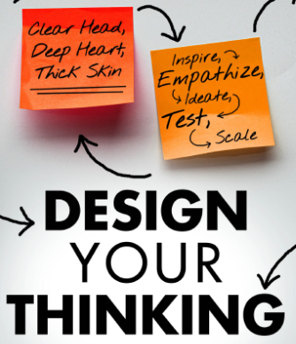
Prototyping in design thinking
Prototyping is about engaging with customers in advance and reaching out to them with a very low-resolution solution to get an early feedback.
Such an approach of iterative rapid-cycle prototyping helps in securing funding, organizational commitment and customer trust, and in building the team’s morale and making them believe they are headed in roughly the right direction.

Slide 63
Prototyping in design thinking
The need for prototyping: A good and early prototype serves three core functions:
1. It takes ideas from the abstract to the concrete, giving them the much-needed body and soul
2. A prototype helps get the buy-in from your team members, senior managers and customers, as at least one of the possible outcomes.
3. Prototyping makes it possible to seek feedback and avenues of improvement more objectively and readily.
One of the masters of the prototyping mindset was Thomas Edison, who famously quipped, ‘None of my inventions came by accident. I see a worthwhile need to be met and I make trial after trial until it comes. What it boils down to is one percent inspiration and ninety-nine percent perspiration.’

Slide 64
The prototyping mindset
It's about learning by doing, iterating rapidly, and embracing failure as a stepping stone to success. It’s prototyping as a process of making things real enough to learn more about them.
Key elements of the prototyping mindset include:
Experimentation: Prototypes are tools for experimentation, allowing designers to test their ideas and gather feedback.
Iteration: Prototyping is an iterative process, meaning that designs can be continuously improved based on feedback and insights.
Failure as Learning: Prototyping encourages a mindset where failure is seen as an opportunity to learn and grow.
User-Centricity: Prototypes should be designed with the user in mind, ensuring that they meet their needs and expectations.
Tangibility: Prototypes should be tangible, allowing designers to experience and interact with their ideas in a concrete way.
Prototyping doesn’t have to just be seen as a development tool. Instead, if you approach this as a way of shaping how you work, it becomes relevant to different situations and at different stages of research, design and delivery.

Slide 65
Guidelines for Prototyping
Just start building Design Thinking has a bias towards action: that means if you have any uncertainties about what you are trying to achieve, your best bet is to just make something.
Don’t spend too much time Prototyping is all about speed; the longer you spend building your prototype, the more emotionally attached you can get with your idea, thus hampering your ability to objectively judge its merits.
Remember what you’re testing for All prototypes should have a central testing issue. Do not lose sight of that issue, but at the same time, do not get so bound to it so as to lose sight of other lessons you could learn from.
Build with the user in mind Test the prototype against your expected user behaviors and user needs. Then, learn from the gaps in expectations and realities, and improve your ideas.

Slide 66
Tools for prototyping
Rely on storyboard and scenarios for prototyping services
A storyboard tells a sequence of events using images, drawings and collages. These can be used to illustrate the user experience with a service or a product.
The storyboard is intended to illustrate user experiences in their context in order to provoke discussions about weaknesses and opportunities for improvement. Storyboards make it possible to visualize the user's perspective and gain useful feedback.
How to do it?
Concretize the theme and message that you want to express through the story.
Define the actors of your story.
Write down the whole story in a script.
Divide the story into sections (scenes).
Choose a suitable graphic representation (drawing, photos).
Create a picture for each scene.
Limit yourself to 6 to 12 images.
Use the storyboard to tell your story efficiently and effectively

Slide 67
Tools for Prototyping
A storyboard is especially useful in the early prototyping phase to present solutions in their context and to make them comprehensible for others. Services have far fewer tangible components, and there is a lot more involvement of the dimension of time, so you must think in terms of sequence of activities, emotional engagements and ‘moments of truth’.
Scenarios allow you to visualize how your solution interacts with users over time. One could test out multiple future scenarios to tease out customer reactions and validate ideas. Scenarios can also help in anticipating unforeseen challenges and thinking up remedial measures, and these are best done with the customer by the side. Meaningful scenarios keep the audience focused on the core of the idea, without getting lost in its mechanics or aesthetics.

Slide 68
Case Study : Story boarding
Imagine you're designing a new mobile app for a fitness tracking service. To visualize the user experience from start to finish, you would create a storyboard.
The Storyboard:
Scene 1: User downloads the app and opens it for the first time.
Image: A smartphone screen showing the app's splash screen.
Description: The app logo appears, followed by a brief animation.
Scene 2: User is presented with a welcome screen.
Image: A smartphone screen displaying a welcome message and a "Get Started" button.
Description: The welcome message explains the app's benefits and encourages the user to continue.
Scene 3: User taps the "Get Started" button.
Image: A smartphone screen showing a sign-up form.
Description: The user is prompted to enter their email address, password, and other relevant information.
Scene 4: User successfully creates an account.
Image: A smartphone screen displaying a confirmation message and a "Continue" button.
Description: The app welcomes the user and provides a brief overview of the features.
Scene 5: User is taken to the app's main dashboard.
Image: A smartphone screen showing the app's dashboard, with various sections like "Activity," "Goals," and "Challenges."
Description: The dashboard provides a personalized overview of the user's fitness data and progress.
Scene 6: User taps on the "Activity" section.
Image: A smartphone screen showing a detailed breakdown of the user's daily activity, including steps, calories burned, and distance traveled.
Description: The user can view their activity data in various formats, such as graphs or charts.
Scene 7: User sets a new fitness goal.
Image: A smartphone screen showing a goal-setting screen with options for weight loss, step count, or distance.
Description: The user can customize their goal and track their progress over time.

Slide 69
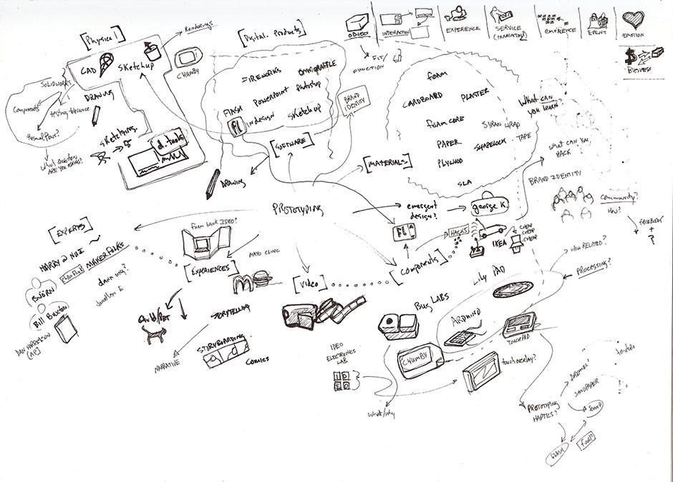
Tools for prototyping
Sketches
While sketches are often considered to not be technically prototypes, they can be extremely helpful for making decisions, mostly because they are incredibly easy to create and even easier to discard. We don’t need any artistic skill to sketch well, so this is a great tool for designers and non-designers alike.

Slide 70
Tools for prototyping
Pros of sketches
They are extremely cheap and fast to create. As such, you can sketch out a large number of ideas in a short amount of time.
You can do it anywhere: with pen and paper or digitally on your smartphone, tablet or desktop computer.
They are disposable, so you won’t get attached to sketches that turn out to be bad ideas.
Cons of sketches
Sketches lack detail and are ambiguous by design. As such, you cannot use sketches to convey complex interactions of an app.
Sketches are almost never of high enough fidelity to be useful with people outside of the team, since they rarely have the context to understand what the sketch is meant to convey.
Sketches are not very helpful in convergent processes where you want to select a few best ideas—other forms of prototypes, such as paper prototypes or wireframes, are more helpful.

Slide 71
Tools for prototyping
Paper Prototypes
Paper prototype sketching templates can help you speed up your process. However, you don’t need them and simple sketches on blank sheets of paper will work just as well.
You don’t even need to use a ruler—however, you should ensure your paper prototypes are neat and legible, of course.
Test your paper prototypes on users. Play-act with them to let them know what happens when they click on a certain button, for instance.

Slide 72
Tools for prototyping
When to Use Paper Prototypes
Use paper prototypes when you’re exploring novel solutions, to test whether people understand your solution.
Don’t use paper prototypes when you’re revisiting the same solution, or using a standard user interface pattern to solve a problem.
Use paper prototypes when you’re exploring different ways of solving a problem. For instance, if you have different interface ideas to achieve the same user goal, you might want to sketch out a couple of different paper prototypes to test them on users.

Slide 73
Tools for prototyping
Pros of Paper Prototypes
Paper prototypes are cheap and easy to create as well as modify.
You can create rough “animations” by sliding pieces of paper to give users a more realistic idea of how the interface will work.
You can ignore the deeper, superficial details of an interface, such as the color of a button. This allows you to test the concept of your idea, rather than its visual execution.
Paper prototypes are very obviously unfinished; therefore, users are unlikely to hold back their critiques for fear of hurting your feelings.
Cons of Paper Prototypes
While generally easy to create, sometimes you might spend a bit of time to make a paper prototype. You might get emotionally attached as a result and become unable to objectively evaluate its merits. Paper prototypes are less helpful to test commonly used user interface patterns.
You can only test paper prototypes in person. Since the prototype is physical, you’ll find it very difficult to conduct remote tests with it.
While better than sketches, paper prototypes still require imagination from users.

Slide 74
Tools for prototyping
The power of role-playing: it’s able to show that a particular type of approach is inadequate for a certain type of user. When dealing with human interactions, this tool discovers qualitative information that cannot be extracted solely by the use of logical reasoning, and that this is only revealed when the expected innovation is made tangible.
It’s an improvised simulation of a situation that can represent anything, from the interaction between a person and a machine, to a simple dialogue between people to enact the aspects of a service.

Slide 75
Tools for prototyping
Select either a group or at least two people to participate in the role-playing activity. It’s important to have dialogues and all participants must allow themselves to improvise and behave in the most natural manner possible.
Every “actor” selected is given a role, for example, a call-center operator registering a complaint from an unsatisfied customer. Objects may be used to obtain an experience or to create a scenario in such a way that the actions and interactions are not only between the actors, but also between the objects. Just like a theater performance, role-playing has no limits: you need to use your imagination!

Slide 76
Tools for prototyping
Mock-Ups
Mock-ups are dummies that simulate the user interface of an executable program, sometimes even functions. This makes it possible to test the planned solution before developing it completely.
Mock-ups should feel realistic so that testers and customers can provide specific feedback and ask specific questions. User tests with mock-ups increase the quality and user-friendliness of the developed program already before its first completion.
How to do it?
Define which components of the idea should be represented.
Decide on an implementation form (paper, mock-up tool).
First design the frame components.
Then move on to designing the more specific components.

Slide 77
Tools for prototyping
Mock-ups are useful:
When promising ideas have already been further developed and they result in a consistent concept.
To test whether this solution is visually feasible and clear for the user. The mock-up gives the customer a first realistic impression of the later program.

Slide 78
Tools for prototyping
Pseudo-code is "language" where you can write all of your coding logic without writing one line of language-specific code.
There are projects that are so massive that if you don't take the time to write a little pseudo-code, you could end up lost in a sea of implemented code. When you write some pseudo-code, it gives you a chance to really think through potential issues. You're able to look at pure logic and program flow without worrying about how your code runs.

Slide 79
Tools for prototyping
Writing pseudo-code before you start typing real code will also help you finish your projects faster.
Think of it as a blueprint.
The best part is that pseudo-code doesn't depend on any programming language. That logic you just wrote out can be taken by anyone and translated into their language of choice. It gives you the freedom to reuse and improve the architecture of the application that you're building.
One of the more subtle uses of pseudo-code is to share it with other people.
Another great feature is that you can write pseudo-code in any format you like.

Slide 80
Tools for prototyping
Interaction flows:
Flowcharts are diagrams of user flows and tasks in processes. Designers use these versatile tools to visualize the interactions in designs and present easy-to-understand maps of designs to stakeholders. They connect labeled, standardized symbols with lines to show everything users might do in interactive contexts.
Designers use flowcharts mainly to plot how users move through an interface, such as an app, to achieve their goals.
Flowcharts represent interactive sequences at two levels:
User flows – Overviews of the complete process of steps which users might take through a whole app, service or website (e.g., from accessing a webshop’s landing page to confirming purchases).
Task flows – Specific aspects of the above (e.g., just the checkout process).

Slide 81
Tools for prototyping
You can use flowcharts especially effectively to:
Visualize interactions for ideation and exploration – to:
Account for all possible interactions (at the start of the design process, to shape user flows).
Evaluate your design’s efficiency – anytime during or after development:
Present to stakeholders:
Internal stakeholders can examine flowcharts whenever you need approval/buy-in before you can proceed to prototyping.
External stakeholders (e.g., clients) can understand your project’s scale and scope

Slide 82
Tools for Prototyping
Remain open to feedback
One of the key principles of design thinking is to seek timely and honest feedback from the people who matter. A delayed or skewed feedback does not help the progress of your problem-solving or innovation sprint and, resultantly, the mistakes become far too costly to correct.
When demonstrating your prototype, bear in mind that the intent is to solicit honest feedback and not sell the concept. This is a very tricky balance to achieve, especially if you are working under a tight schedule without easy access to your intended customers.

Slide 83
Napkin Pitch
The napkin pitch is a framework for communicating a concise summary of an idea or concept. Using this style to describe your ideas or strategy for a new concept can ensure that the description stays simple and short.
The napkin pitch provides a simple, consistent format for summarizing and communicating new concepts.
For a given concept, the napkin pitch describes the target stakeholders, their unmet need, and why your offering creates novel value for them; the elements you will make, buy, and partner for; the channels you will use; and the potential rivals or other factors to watch

Slide 84
Napkin Pitch
The "Napkin Pitch" is an effective tool that provides a simple format to summarize and communicate a new concept - and thereby engage stakeholders and gain their buy-in. You should be able to use questions to create a Napkin Pitch.
The Big Idea - This is where you describe the concept
Needs/Benefits - Who wants this? What unmet needs does it serve? How will the stakeholder/s benefit?
Execution - How will we deliver? What assets and capabilities does this leverage or require? What partners do we need?
Business Rationale - How will this address the opportunity/challenge we have defined? Is there any duplication between our proposal and what already exists? What makes us uniquely capable of delivering this? How will our competition react? How will we sustain our advantage?
The reason for using a napkin is to keep it short, simple and under 60 seconds. If you can't sell the premise in that time, then chances are the problem is not well defined or you haven't locked in the real outcome.

Slide 85
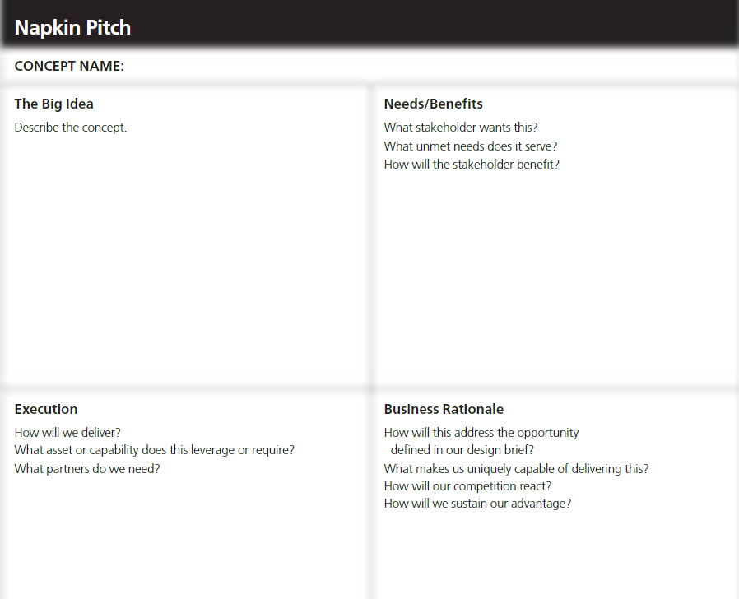
Napkin Pitch

Slide 86
Minimum Viable Product
Imagine you’ve got a brilliant business idea and all your close ones liked it and encouraged you to try. Can you be sure they did so not only because they didn’t want to hurt you and break your relations? Before investing every single penny into developing a full-feature solution, you need to check your hypothesis with a broader, not-biased audience.
You can do this by creating a minimal version of your product with core features that address the primary customer’s problem you’re going to solve.
The main purpose of an MVP is to test the essence of the product idea, analyze users’ feedback, and create a full product version based on the insights.

Slide 87
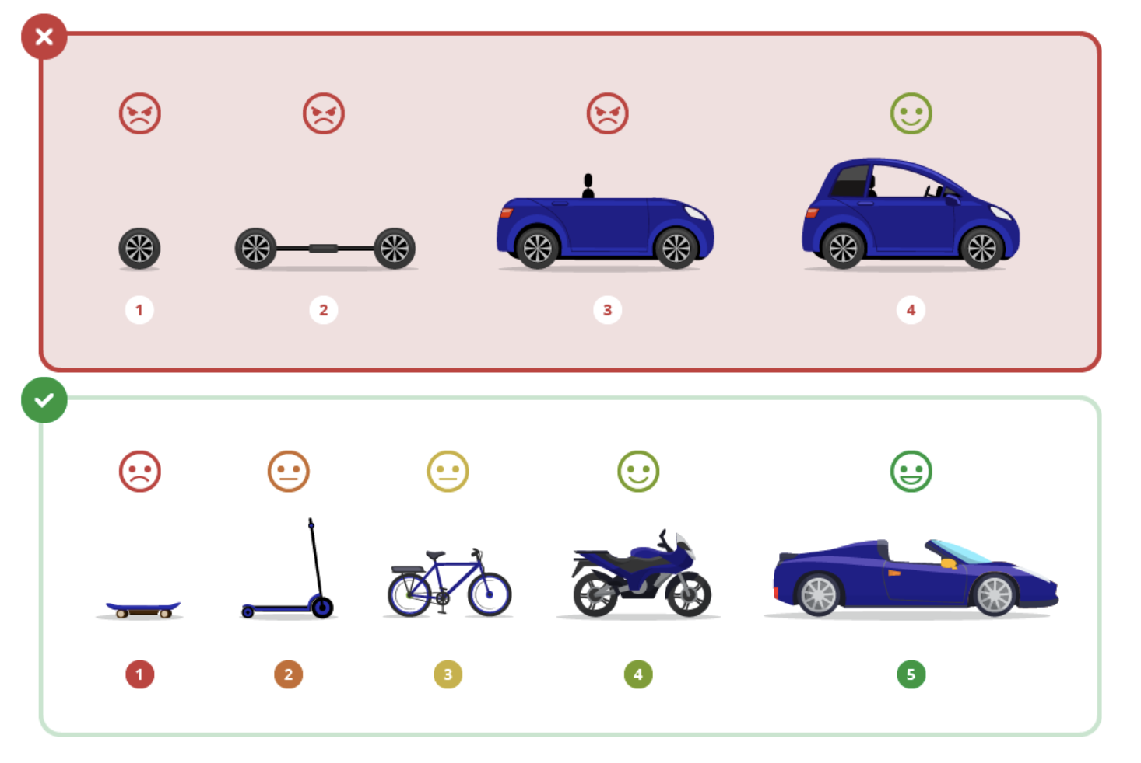
Minimum Viable Product
In the B2B world, the experts say that it’s not an MVP until you can’t sell it. The picture below perfectly illustrates a proper MVP approach.

Slide 88
Minimum Viable Product
MVP, or minimum viable product, is a test version of a product or service with a minimum set of functions that brings value to the end consumer.
The keyword here is “value”. Vague word “viable” means that the product actually solves the user’s problem. And if after testing we find out that it is not viable enough, we start it all over. That is why “minimal” is important: the less investment we make in the beginning, the easier it is to discard the failed product and build a new one.
So, instead of asking “What is a minimum viable product?” we should be asking “What makes a good minimum viable product?”

Slide 89
Minimum Viable Product
Here is a check-list for designing a good MVP
Define the problem and target audience
Run research on both users and competitors
Find that minimal set of features that are enough to solve the problem
Don’t forget about testing
However, even with such a clear concept as an MVP, there are a bunch of misinterpretations that make some product managers create non-viable minimum products and others

Slide 90
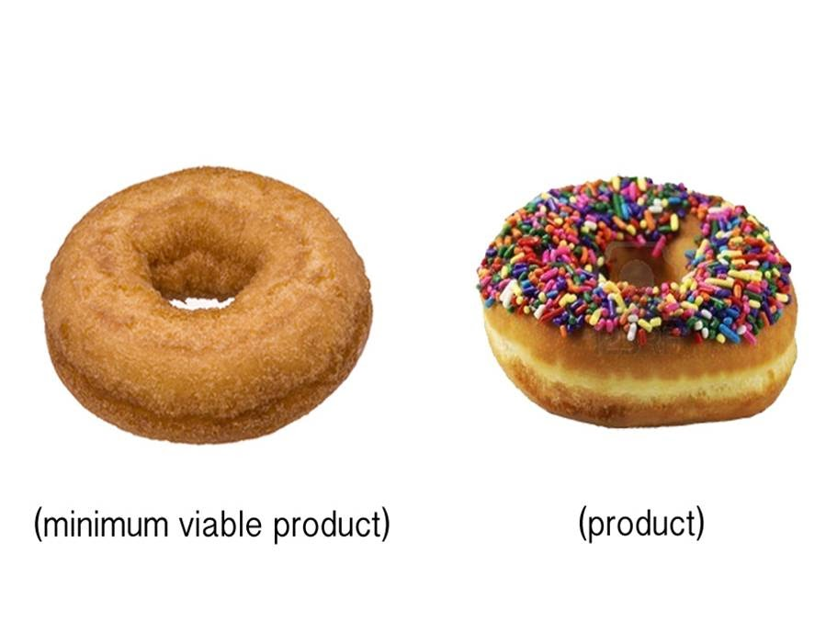
Minimum Viable Product
Here's a perfect example of an MVP:

Slide 91
MVP benefits
Creating the MVP helps:
Understand if there is a market for your idea
Evaluate product’s potential
Gather customers’ insights
Reveal a product’s weak points
Attract investors for future funding
Enhance your product to satisfy market needs
Reduce engineering hours narrowing down the feature set
Avoid unnecessary expenses

Slide 92
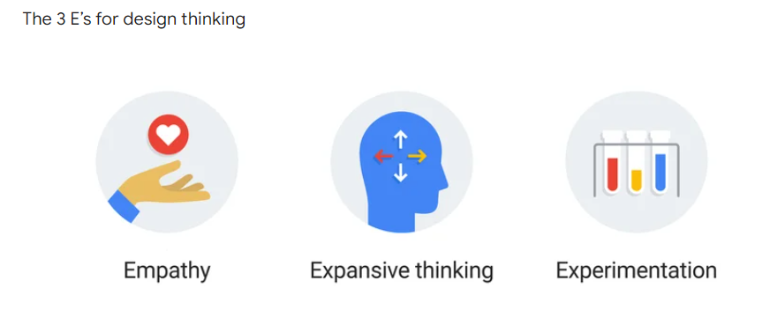
Connecting prototype with 3 Laws
When you need to solve a problem, you can grow your team’s creative capacity by focusing on three core design thinking principles, or the 3 E’s: empathy, expansive thinking, and experimentation.

Slide 93
Connecting prototype with 3 Laws
Empathy
It’s great to create an innovative product or service. It’s not so great to build one that’s useless to people. That’s why your users should be your No. 1 focus. When you can empathize with them and take inspiration from their needs, feelings, and motivations, your team can create meaningful solutions to actual problems.
Expansive thinking
Expansive thinking, also known as brainstorming, is all about creating multiple ways to solve a problem or improve a situation. Instead of trying to think of one perfect solution, think about reframing your problem or looking at it from all conceivable angles to get several possible solutions. It’s OK that most of the ideas your team comes up with won’t end up working.
To begin your brainstorm, try challenging your team to come up with ideas that aren’t just 10% better than the status quo but 10X better. Basically, thinking big — like, really big — can give you radical new ideas.

Slide 94
Connecting prototype with 3 Laws
Experimentation
Once you have a list of ideas, you’ll need to start learning which ideas work and which ones don’t — fast. This is where you begin experimentation or building prototypes.
In the prototyping phase, you’ll build an early-stage version of your idea and test it out on a small group to see what actually works. Then, gather data to decide if it makes the most sense to move your idea forward, kill it, or tweak it.
Decide based on the project how you’d like to prototype. For example, you can test a product internally before releasing it to the public, or release a new service in beta to get feedback from people outside the company before a wide release.

Slide 95
A/B Testing
A/B testing is an experiment.
Sometimes called split testing, it is a method for comparing two versions of something to determine which one is more successful.
To identify which version a design approach is better, two versions are created at the same time, each version shown to half of the same target audience.
The test measures which one performed better with the target audience. The version that prompts the most users take the desired action, or the better conversion rate, is the winner.

Slide 96
A/B Testing
Almost any content and settings can be tested:
web pages and their elements;
ads;
management strategies and approaches;
emails and mailing list items,
A/B testing there must be at least two versions of the item to be tested: version A and B. For example, we could test the design of a webpage or a single screen in a mobile application. Half of the traffic is shown one version (A) and half is shown the modified version (B). The different versions are shown to users at random. Each user’s response is recorded in an analytics or testing tool so it can be measured. Once the test is complete, statistical analysis is used to assess the results .
The experiment may show that the change had a positive or negative impact or no impact at all.

Slide 97

A/B Testing
Example: The debate was about the best color for the toolbar on the webpage. The design team was fond of a particular shade of blue while the product manager was advocating for a greener hue. Both parties had strong opinions about their choice. Who gets to decide? Was the choice right? And does it really matter anyway?

Slide 98
A/B Testing
Decisions like this are often made based on diplomacy, authority, or opinion. The debate recounted above is an often retold tale from Google, and the story has endured because the team eventually tested 41 gradations of blue to see which users preferred. Why?
It’s about more than usability or user experience. Whether or not a design choice leads to clicks can have an impact on a revenue stream. Companies like Google know the importance of conducting experimentations like A/B testing to determine the right approach with data—not an opinion or a guess.
Whether the goal is to improve a landing page or a call-to-action button, A/B testing is the best way to help UX teams and marketers make incremental changes over time. A well-designed A/B test will help the team decide between two buttons, two fonts,
A/B tests tell us what’s not working, and what is successful, rather than merely what has the potential for success. In short, the results from A/B tests can lead to informed decisions based on data, and not just opinions.

Slide 99
A/B Testing
A/B testing can help:
Make informed decisions
Confirm a new design is going in the right direction
Decide which version of different approaches to implement
Figure out what is working best among specific UI or copy elements
Learn how small changes can influence user behavior
Constantly iterate a design
Improve user experience over time
Optimize conversion rates

Slide 100
Learning Launch
Once your prototype is approved, it goes to the final end-user, your customer. Learning Launch is the tool wherein your test product is launched in the market for a quick experiment.
In contrast to a new product launch, this test is conducted solely for gathering data.
As a design thinking tool, Learning Launch can be difficult to navigate through. After all, liking your product does not mean one will buy it.
Money is dear to all, and the real challenge lies in convincing the customer to part with it willingly to buy your product. While one may say that’s the job of advertising and marketing, the first step towards initiating the process of willful buying happens through this stage.
The most critical aspect of this tool is that unlike traditional analysis and case studies that happen over a long period, this approach works for short periods.

Slide 101
Learning Launch
Since there is no perfect algorithm to achieve the perfect product, design thinking uses this tool to learn along the way.
For example, post-lockdown, the French government’s initiative to make the country green, sustainable and inclusive translated into making 650-km bicycle lanes throughout the territory. It was an urban planning project that worked along the learning launch process to see what works best
A learning launch is a carefully designed experiment or prototype designed to test the key underlying value-generating assumptions of a potential new-growth initiative.
The purpose of a learning launch is to learn. If you learn valuable information, the learning launch is a success, whether the particular idea is validated or not.

Slide 102
Decision Making Tools and Approaches
1. Visualization is about using images. It’s not about drawing; it’s about visual thinking. It pushes us beyond using words or language alone. It is a way of unlocking a different part of our brains that allows us to think nonverbally and that managers might not normally use.
2. Journey mapping (or experience mapping) is an ethnographic research method that focuses on tracing the customer’s “journey” as he or she interacts with an organization while in the process of receiving a service, with special attention to emotional highs and lows. Experience mapping is used with the objective of identifying needs that customers are often unable to articulate.
3. Value chain analysis examines how an organization interacts with value chain partners to produce, market, and distribute new offerings. Analysis of the value chain offers ways to create better value for customers along the chain and uncovers important clues about partners’ capabilities and intentions.
4. Mind mapping is used to represent how ideas or other items are linked to a central idea and to each other. Mind maps are used to generate, visualize, structure, and classify ideas to look for patterns and insights that provide key design criteria.
5. Rapid concept development assists us in generating hypotheses about potential new business opportunities.

Slide 103
Decision Making Tools and Approaches
6. Assumption testing focuses on identifying assumptions underlying the attractiveness of a new business idea and using available data to assess the likelihood that these assumptions will turn out to be true. These assumptions are then tested through thought experiments, followed by field experiments, which subject new concepts to four tests: value creation, execution, scalability, and defensibility.
7. Prototyping techniques allow us to make abstract new ideas tangible to potential partners and customers. These include storyboarding, user scenarios, experience journeys, and business concept illustrations — all of which encourage deep involvement by important stakeholders to provide feedback.
8. Customer co-creation incorporates techniques that allow managers to engage a customer while in the process of generating and developing new business ideas of mutual interest. They are among the most value-enhancing, risk-reducing approaches to growth and innovation.
9. Learning launches are designed to test the key underlying value-generating assumptions of a potential new-growth initiative in the marketplace. In contrast to a full new-product rollout, a learning launch is a learning experiment conducted quickly and inexpensively to gather market-driven data.
10. Storytelling is exactly how it sounds: weaving together a story rather than just making a series of points. It is a close relative of visualization—another way to make new ideas feel real and compelling. Visual storytelling is actually the most compelling type of story. All good presentations—whether analytical or design-oriented — tell a persuasive story.

Slide 104
Vroom Yetton Matrix
There are lots of different ways of making a decision and choosing your approach can be just as difficult as making the decision itself!
Sometimes you have to take charge, and decide what to do on your own, but you don't want to appear autocratic to your team (particularly in situations where you need their input). At other times it's better to make a decision based on the group consensus, but this can use up precious time and resources. So how do you decide which approach is best?
Every manager needs to be able to make good decisions. It can also help you to determine the most effective means of reaching a decision.
Notes:
developed by Victor Vroom and Philip Yetton in their 1973 book, "Leadership and Decision Making."

Slide 105
Vroom Yetton Matrix
Understanding the Model
Before you start using the model, you'll need to consider these three factors:
Decision quality – Sometimes, making the "right" decision is critical, and you'll need to use a large number of resources (people, time, information, and so on) to ensure that the action you take has been well thought through and is of high quality.
Team commitment – Some of your decisions will have a major impact on your team, while others will go unnoticed. When a decision will likely impact your team, it's best to use a collaborative process.
Time constraints – When the issue at hand isn't time sensitive, you have more "space" to research your options and to include others, which will help to boost the quality of your decision.
Notes:
developed by Victor Vroom and Philip Yetton in their 1973 book, "Leadership and Decision Making."

Slide 106
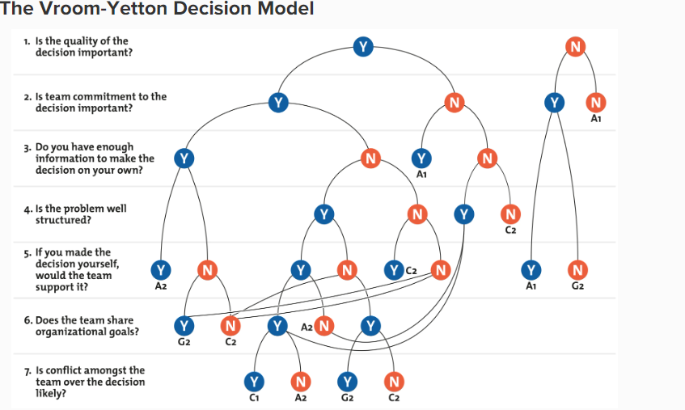
Vroom Yetton Matrix
The framework poses seven "yes/no" questions, which you need to answer to find the best decision-making process for your situation.
As you answer each of the questions, you work your way through a decision tree until you arrive at a code (A1, A2, C1, C2, or G2). This code identifies the best decision-making process for you and your team.
Notes:
developed by Victor Vroom and Philip Yetton in their 1973 book, "Leadership and Decision Making."

Slide 107
Vroom Yetton Matrix
The following codes represent the five decision-making processes that are described by the model:
Autocratic (A1): You use the information that you already have to make the decision, without requiring any further input from your team.
Autocratic (A2): You consult your team to obtain specific information that you need, and then you make the final decision.
Consultative (C1): You inform your team of the situation and ask for members' opinions individually, but you don't bring the group together for a discussion. You make the final decision.
Consultative (C2): You get your team together for a group discussion about the issue and to seek their suggestions, but you still make the final decision by yourself.
Collaborative (G2): You work with your team to reach a group consensus. Your role is mostly facilitative, and you help team members to reach a decision that they all agree on.

Slide 108
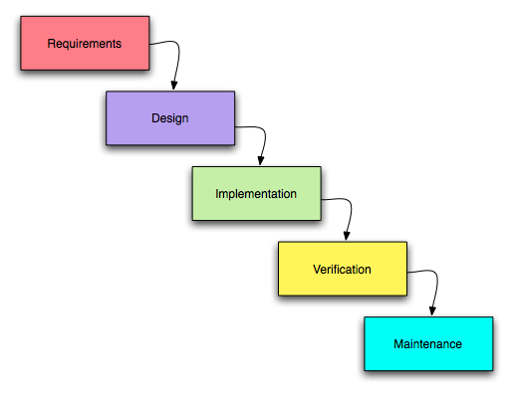
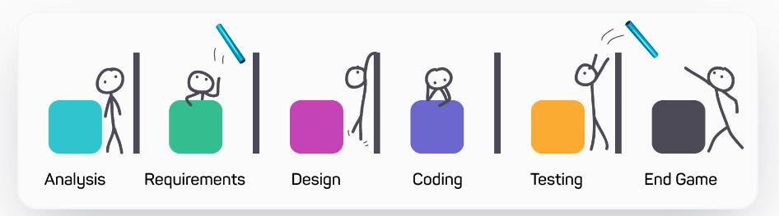
Shift Left/Shift Right
“Waterfall” process project back in the mid-1980s, It was a linear progression

Slide 109
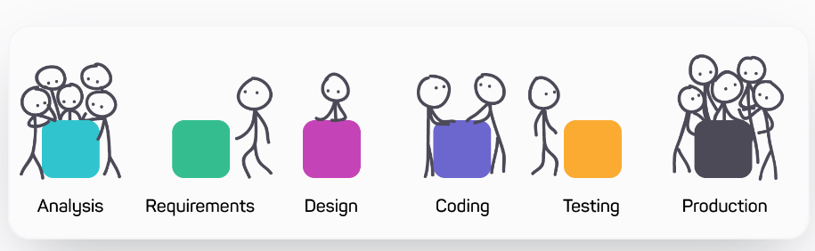
Shift Left/Shift Right
Shifting Gears to Shift Left, Shift Right
Shift Up means to start working much more effectively or quickly, or with more energy.
Shift left means moving the person, process, or technology closer to the customer, resulting in a faster and more efficient and effective resolution.
Shift-right is the practice of performing testing, quality, and performance evaluation in production under real-world conditions

Slide 110
Shift Left/Shift Right
When people say “shift left” today, they may retain a bit of that waterfall thinking, and see a static “beginning” for a new software project.
By “shift right”, people mean that they aren’t going to just throw the feature over the wall to ops when it deploys, they’re going to monitor, observe, analyze log data, and “test in production.”
There’s No Beginning, There’ll Be No End (Hopefully!)
Shifting towards the “beginning/left” or the “end/right” of software delivery doesn’t make sense for a team using agile and Develops principles and practices to deliver value to customers frequently, at a sustainable pace. Modern software development is an infinite loop of developing small chunks of features, getting feedback as they are used in production (perhaps by a small number of people), and continuing to add, remove, and change them based on what we learn from the feedback.
Because today’s software development is continual, we now talk about “continuous testing”

Slide 111
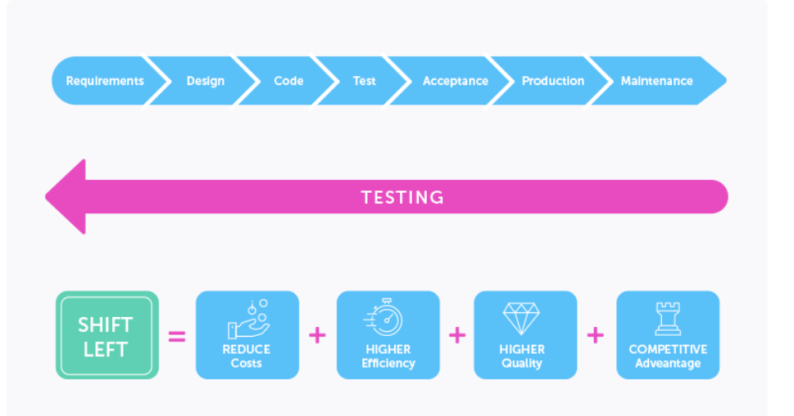
Shift Left/Shift Right
The shift left is a concept from the test strategy and the QA.

Slide 112
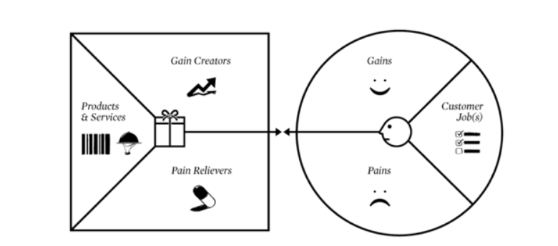
Value Proposition Design
Value Proposition Design allows you to map products and services against customer gains and pains to create new value propositions or improve existing ones.
Value Proposition Design is a visual tool, a template that consists of two sides — the value map (left-hand side below) and the customer profile (right-hand side). Using this tool, you can identify how your products and services provide gains and ‘pain relief’ for your customers.

Slide 113
Value Proposition Design
Start on the right-hand side, by listing all the customer needs (including the problems they're trying to solve and the duties they perform) under the customer job(s). In customer pains, list the things that make it difficult for your customer to get their ‘jobs’ done. Finally, in customer gains jot down all the customer’s benefits and desires.
Then on the left-hand side, list all the products and services on which your value proposition is built. In the pain relievers section, write down all the ways your products and services address the customer’s pains. And finally, write in how your products/services create customer gains.
Value Proposition Design can be used to help you create new value propositions or improve existing ones. It’s a great way to nail down your value proposition, see any gaps and ensure you’re delivering true value to your customers.
In terms of digital projects, Value Proposition Design can help deliver user-centric projects, and helps you create value for your customers and prospects.

Slide 114
Case Study: Careerbuddy
Careerbuddy Case Study - OneDrive (sharepoint.com)

Slide 115
Case Study: IBM Learning Launch
https://www.coursera.org/lecture/uva-darden-design-thinking-innovation/the-ibm-story-iq0kE

Slide 116
Case Study: You Me Health Story
https://www.coursera.org/lecture/uva-darden-design-thinking-innovation/the-meyouhealth-story-part-i-what-is-W6tTs https://www.coursera.org/lecture/uva-darden-design-thinking-innovation/the-meyouhealth-story-part-ii-what-if-YSBV7

Slide 117
Daily Quiz
After you Ideate, the next step is to…
(a) Test
(b) Prototype
(c) Define
(d) Empathise
Which of the following best describes the 100 rule?
When you are brainstorming and run out of ideas, relax and count to 100 before beginning the process again.
Brainstorming 100 different ideas for the essay topic you have been assigned.
To write at least 100 lines for an essay.
Deciding on an essay topic in 100 seconds or less.
Which of the following is a benefit of group brainstorming?
The length of time that it takes to complete the process.
Individuals may not feel comfortable speaking in a group setting.
The creativity of some individuals' may be discouraged.
Debating ideas as a group can lead to additional ideas.

Slide 118
Weekly Assignment
Define prototyping.
Explain the tools used in prototyping.
Discuss the importance of garnering user feedback for revisiting Brainstormed ideas
Explain any two decision Making Tools and Approaches.
Briefly discuss SWOT analysis.
Explain three laws of design thinking.
Write short note on: (1) physical mockups and (2) storyboards
Explain the 10-100-1000gm & QBL law.
Discuss the rules of brainstorming.
Explain the 5 steps of design thinking.

Slide 119
MCQ s
A well-defined and clearly stated problem needs to be addressed during the session.
True
False
Which of the following is a benefit of group brainstorming?
The length of time that it takes to complete the process.
Individuals may not feel comfortable speaking in a group setting.
The creativity of some individuals' may be discouraged.
Debating ideas as a group can lead to additional ideas.

Slide 120
Glossary Question
Brainstorming, Empathy, Ideation, minimum viable product , Opportunities,
1. Expansive thinking, also known as ……………………….
2. Brainstorming is one of the primary methods employed during the ……………. stage of a typical Design Thinking process.
3. SWOT stands for Strengths, Weaknesses, …………………. , and Threats.
4. …………………….. is a test version of a product or service with a minimum set of functions that brings value to the end consumer.
5. First stage of design thinking is …………………….

Slide 121
Expected Questions for University Exam
Explain the importance of brainstorming in identifying the reasonable solutions to problems.
Define prototyping and explain the tools used in prototyping.
Discuss the importance of garnering user feedback for revisiting Brainstormed ideas
Explain any two decision Making Tools and Approaches.
Briefly discuss SWOT analysis.
Explain three laws of design thinking.
Write short note on: (1) physical mockups and (2) storyboards
Explain the 10-100-1000gm & QBL law.
Discuss the rules of brainstorming.
Explain the 5 steps of design thinking.

Slide 122
Recap of Unit
Refine and narrow down to the best idea, 10-100-1000gm, QBL, Design Tools for Convergence – SWOT Analysis for 1000gm discussion. In-class activity for 10-100-1000gm & QBL | To learn different types of design tools
Prototyping (Convergence): Prototyping mindset, tools for prototyping – Sketching, paper models, pseudo-codes, physical mockups, Interaction flows, storyboards, acting/role-playing etc, importance of garnering user feedback for revisiting Brainstormed ideas, | To learn different types of tools used in prototyping and ideation
Napkin Pitch, Usability, Minimum Viable Prototype, Connecting Prototype with 3 Laws, A/B Testing, Learning Launch. Decision Making Tools and Approaches – Vroom Yetton Matrix, Shift-Left,Up,Right, Value Proposition, Case study: Careerbuddy, You-Me-Health Story & IBM Learning Launch | To understand decision making tools and approaches

Slide 123
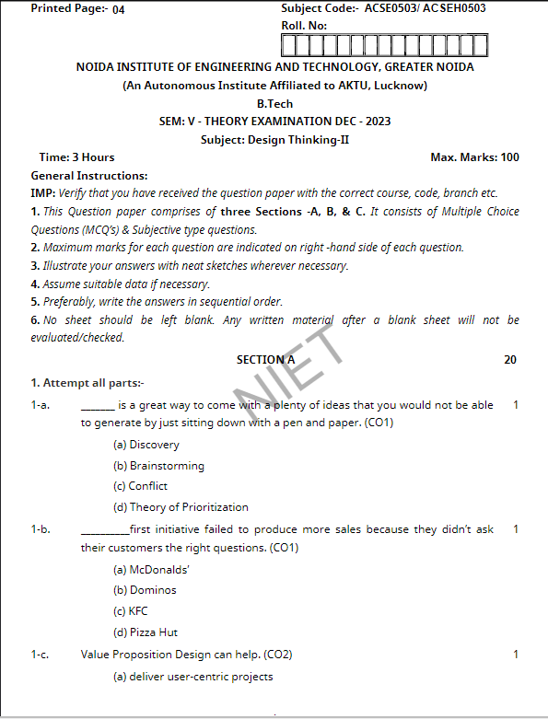
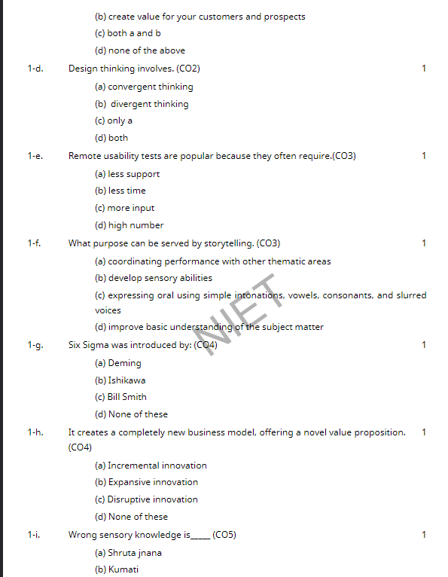
Previous Question Paper

Slide 124
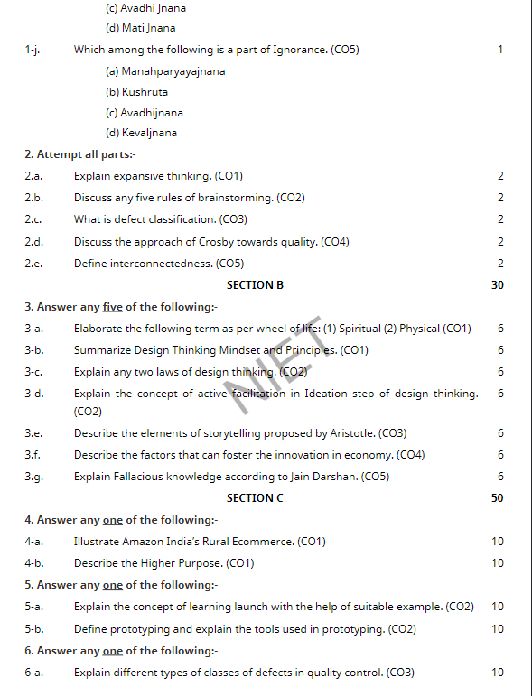
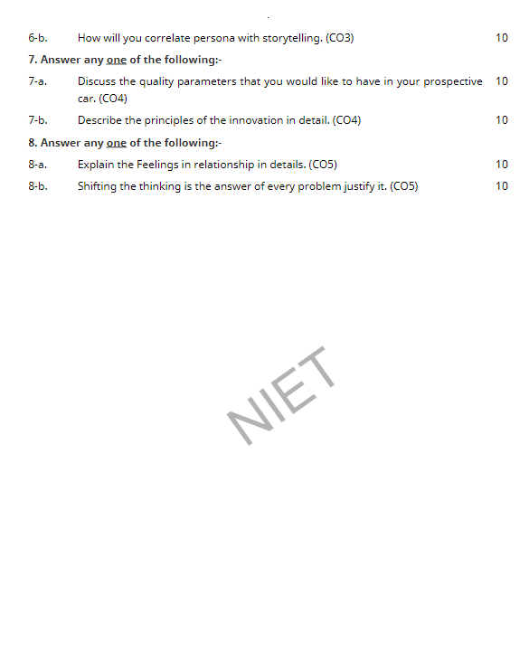
Previous Question Paper

Slide 125
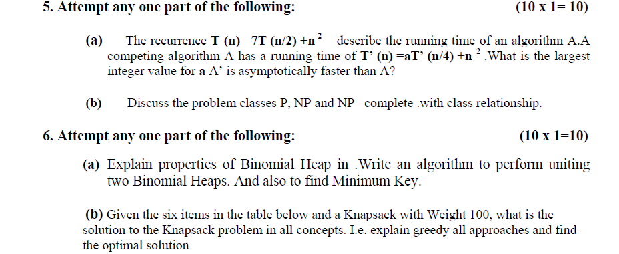
References
https://www.independent.co.uk/news/world/americas/starbucks-barista-learns-sign-language-to- talk-to-deaf-customer-a6890606.html
https://www.interaction-design.org/literature/topics/prototyping#:~:text=Prototyping%20is%20an%20experimental%20process,can%20release%20the%20right%20products.
https://www.uxmatters.com/mt/archives/2019/01/prototyping-user-experience.php
https://uxdesign.cc/prototyping-what-can-a-team-learn-5db78d7da912
https://qpsoftware.net/blog/pros-and-cons-prototyping-complex-projects

Slide 126
Unit 2
Thank You

